Slide 1
Machine Learning 101
Saifeldeen Adel, CEO

Slide 2
Agenda
What is ML
AI vs ML vs DL
Types of ML
Regression - Linear Regression
Building a Linear Regression model
Break
Classification - Logistic Regression
Other Classification Algorithms

Slide 3
01
What is ML?
Everyone’s heard of it, but what is it?

Slide 4
Machine Learning
Machine learning is about teaching computers to make decisions or predictions based on patterns found in data. Doesn’t need to be explicitly taught or told what to do.
Rather than writing detailed instructions on how to perform a task, we provide the machine with a large amount of data, and it 'learns' how to perform the task.

Slide 5
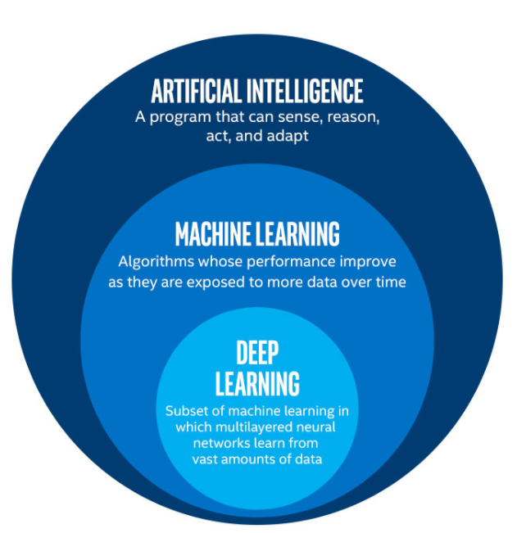
AI vs ML vs DL
AI is the huge field where machines are made to mimic humans. This can include search agents, rule-based systems, and machine learning.
Machine learning introduces the idea that machines learn from data without explicit programming. Lots of data.
DL Neural networks work on extracting unique features in the data and are able to progressively learn more detailed features and produce output

Slide 6
AL vs ML vs DL
Google Maps (shortest path finding)
Spam email detection
Recommendation systems
Camera Facial Detection

Slide 7
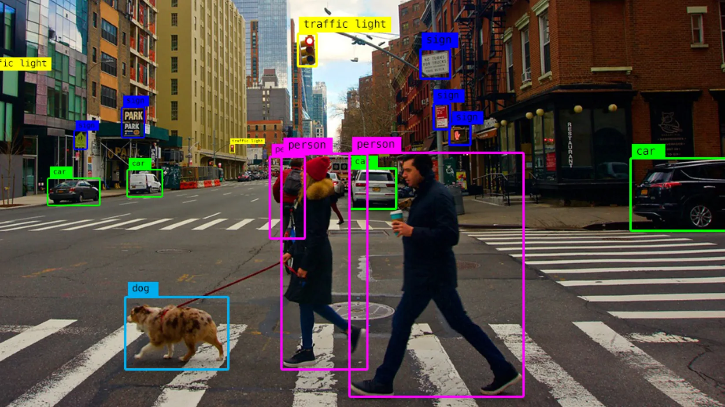
AL vs ML vs DL
Google Maps (shortest path finding) - AI
Spam email detection - ML
Recommendation systems - ML/DL
Camera Facial Detection - DL

Slide 8
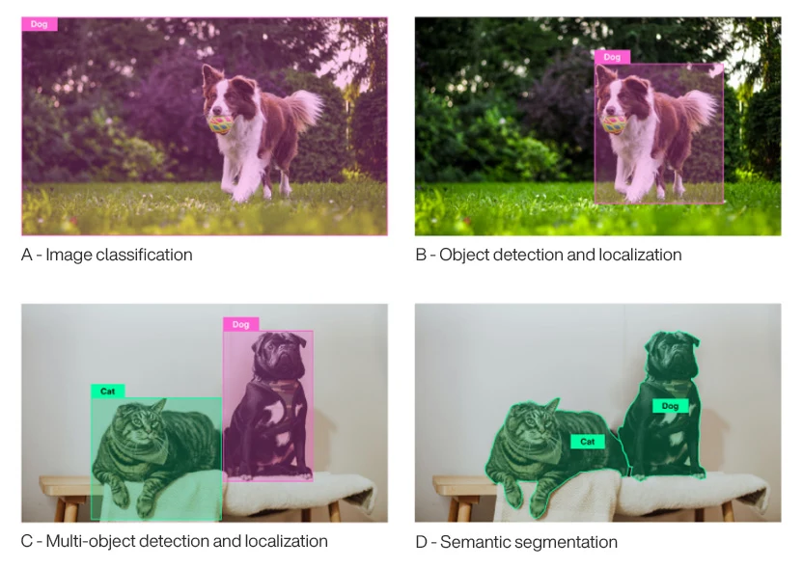
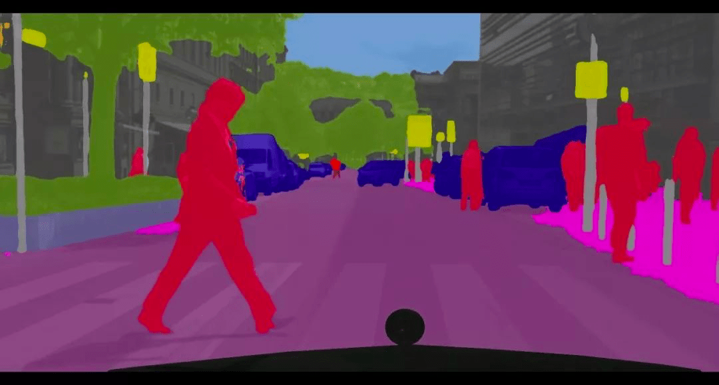

Slide 9
Types of Machine Learning
Supervised Learning
The model is trained on a labeled dataset, which means that each input data point is paired with the correct output. Predicts output on new, unseen data.
Unsupervised Learning
The model doesn’t have labeled data. Since the data isn't labeled, there's no 'correct' answer for the model to learn from. Instead, the model identifies similarities, differences, and groupings in the data.
Reinforcement Learning
Type of machine learning where an agent learns to make decisions by taking actions in an environment to maximize a cumulative reward. Not from a dataset.

Slide 10
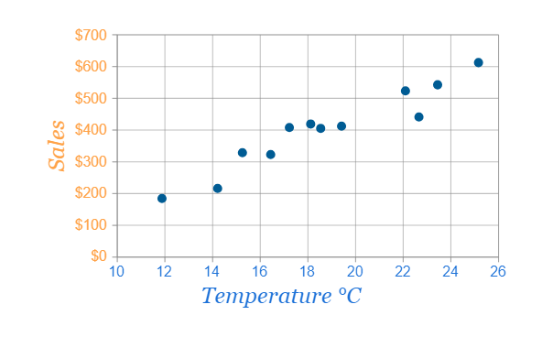
Supervised Learning
Let’s learn some keywords: Dataset, feature, label, target, training set, testing set

Slide 11
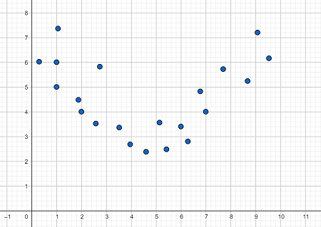
Supervised Learning
Let’s learn some keywords: overfitting, underfitting

Slide 12
Supervised Learning
Let’s learn some keywords: overfitting, underfitting

Slide 13
Supervised Learning
Let’s learn some keywords: overfitting, underfitting

Slide 14
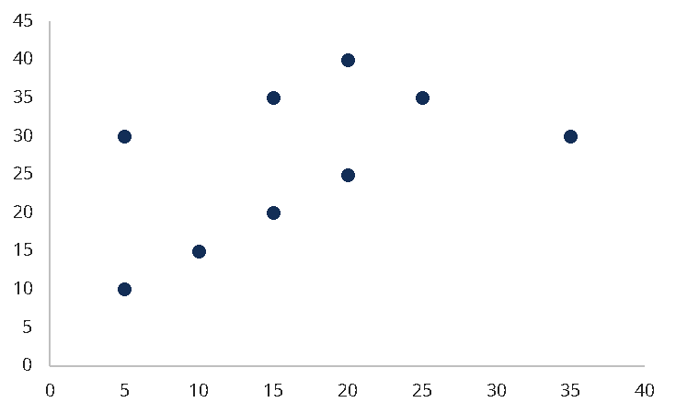
Linear Regression
Linear regression is used to predict a continuous target variable based on one or more input features. In the case of one feature, the goal is find the best straight line that represents the relationship between the feature and output.
Basic line equation
y = m * x + b
Feature: x
Label: y
Parameters to be fitted: m, b

Slide 15
Linear Regression - Starting
Start with random parameters. There is now a cost, or error we can calculate.
Basic line equation
y = m * x + b
m = 1
b = 0

Slide 16
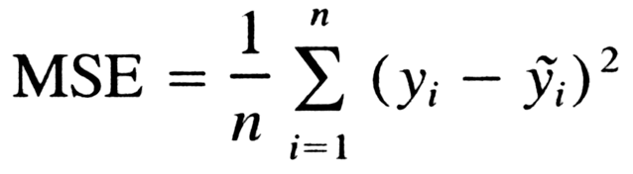
Linear Regression - Mean Square Error
A very common error is the MSE (Mean Square error) and it calculates the error of one particular chosen line.

Slide 17
Linear Regression - Mean Square Error
A very common error is the MSE (Mean Square error) and it calculates the error of one particular chosen line.

Slide 18
Linear Regression - Mean Square Error
A very common error is the MSE (Mean Square error) and it calculates the error of one particular chosen line.
Get the sum of all the errors and square it then get the mean.
Mean…square….error.

Slide 19
Linear Regression - Gradient Descent
How do you optimize and update these parameters?
Let’s plot and visualize this loss function

Slide 20
Linear Regression - Gradient Descent
How do you optimize and update these parameters?
Let’s plot and visualize this loss function
How do we find the minimum of a graph like this?

Slide 21
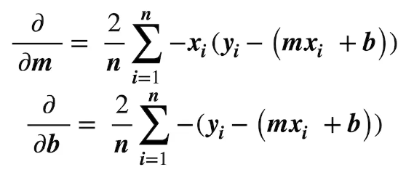
Linear Regression - Gradient Descent
How do you optimize and update these parameters?
Let’s plot and visualize this loss function
How do we find the minimum of a graph like this?

Slide 22
Linear Regression - Gradient Descent
Let’s plot and visualize this loss function
How does the parameter update? And how big of a step should we take?

Slide 23
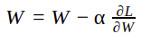
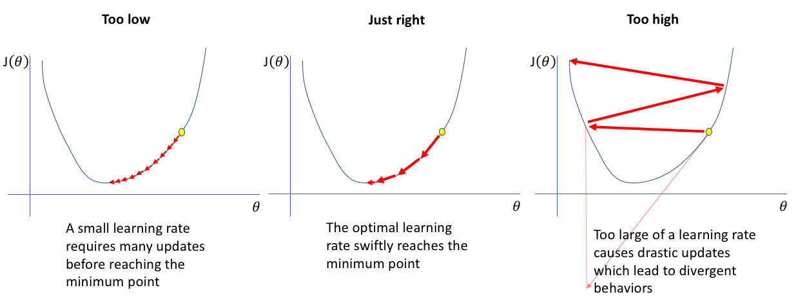
Linear Regression - Learning rate

Slide 24
Hands-on
Let’s build a Linear Regression Model using scikit-learn

Slide 25
Classification - Logistic Regression
What if our labels were a discrete set of values?
{Spam, Not Spam}
{Cat, Dog}
Classification predicts discrete labels or categories, while regression predicts continuous numerical values. Logistic regression is a popular classification technique. Confusing right? Let’s explain

Slide 26
Logistic Regression
Logistic regression is similar to linear regression where we try to fit a line to our data. But instead of a straight line, it will be an S curve. Say we have an obese/not obese dataset based on weight alone. Plotting this would look like this.

Slide 27
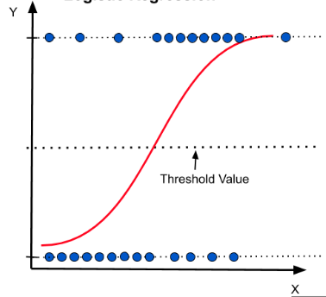
Logistic Regression
The basic idea of logistic regression is to reach a curve that looks like this. Where the y axis is a regression (continuous) value indicating how likely the data point belongs to a certain class.
By introducing a threshold value, we turn this into classification.

Slide 28
Logistic Regression
Fitting the curve is done through a process called maximum likelihood.
Search, search, search. It’s simple.

Slide 29
Classification Algorithms
There are many classification algorithms, all with the purpose of categorizing data into predefined classes or labels.
To predict the class label of new data points based on patterns learned from a labeled training dataset.
K nearest neighbors
Decision Trees
Naive Bayes
SVM

Slide 30
k Nearest Neighbors
Might be the simplest of them all.
Imagine you have a neighborhood full of different types of houses (data points). Each house is already labeled as one of a few categories, say "modern," "traditional," or "cottage."
When a new house appears in the neighborhood, and you want to classify it into one of these categories, what do you do?

Slide 31
k Nearest Neighbors
Might be the simplest of them all.
Imagine you have a neighborhood full of different types of houses (data points). Each house is already labeled as one of a few categories, say "modern," "traditional," or "cottage."
When a new house appears in the neighborhood, and you want to classify it into one of these categories, what do you do?
You look at the nearest houses to it.

Slide 32
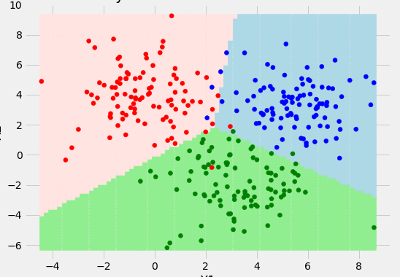
k Nearest Neighbors
More accurately, you look at the k nearest houses.

Slide 33
k Nearest Neighbors
More accurately, you look at the k nearest houses.
The kNN algorithm stores the whole dataset. By storing the whole dataset, any new data points introduced can be easily classified based on distances calculated.
What if our k is too high?
What if our k is too low?
What if our data is high-dimensional, what do you consider “near”?

Slide 34
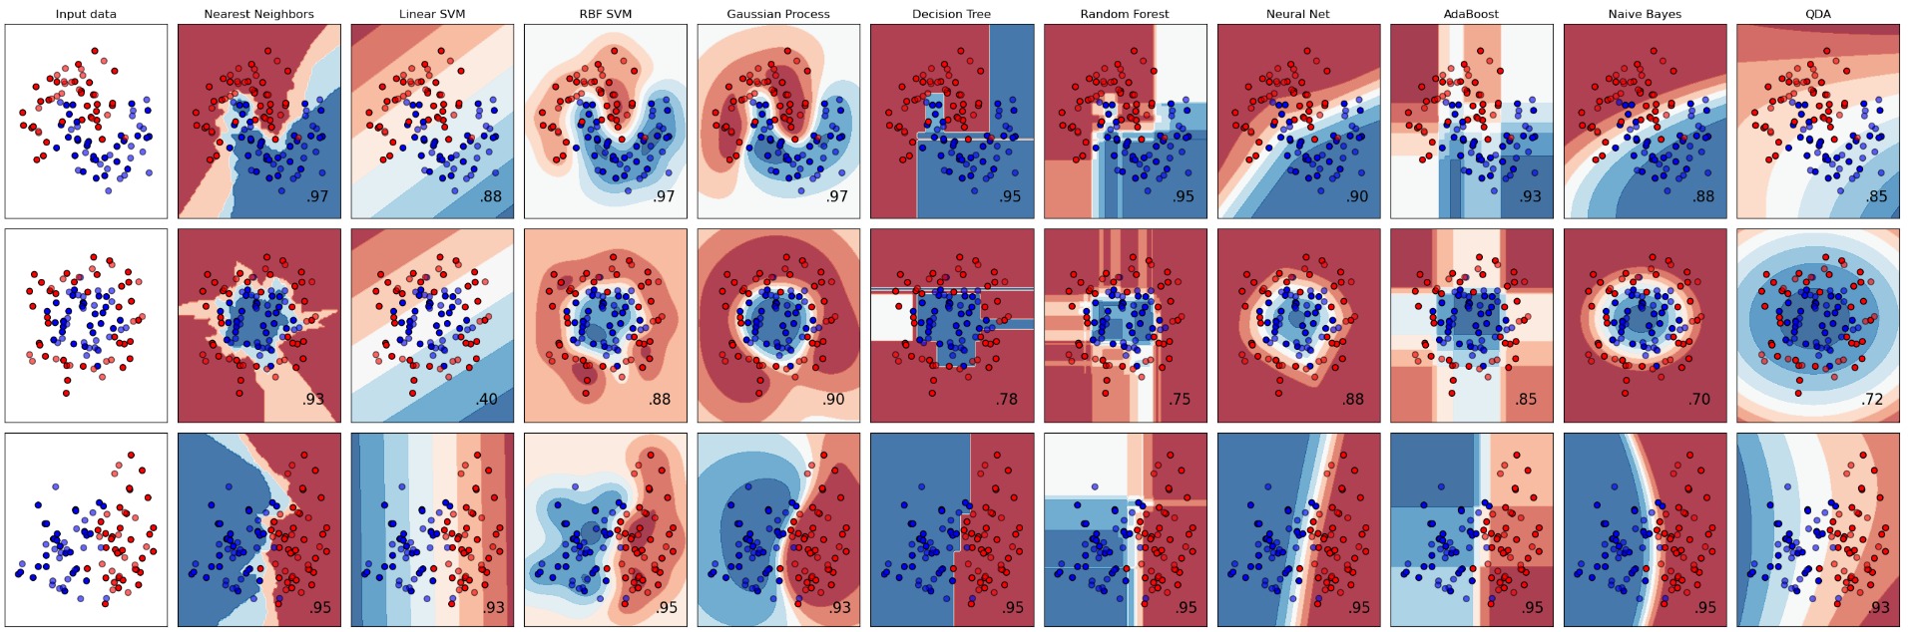
Other algorithms
Other algorithms address these problems but they also have their problems. It’s important to try out different classifiers to determine the ones more suited for our specific task.
scikit-learn has a huge collection of classifiers ready to run.

Slide 35
Thank you!

